Slide 1
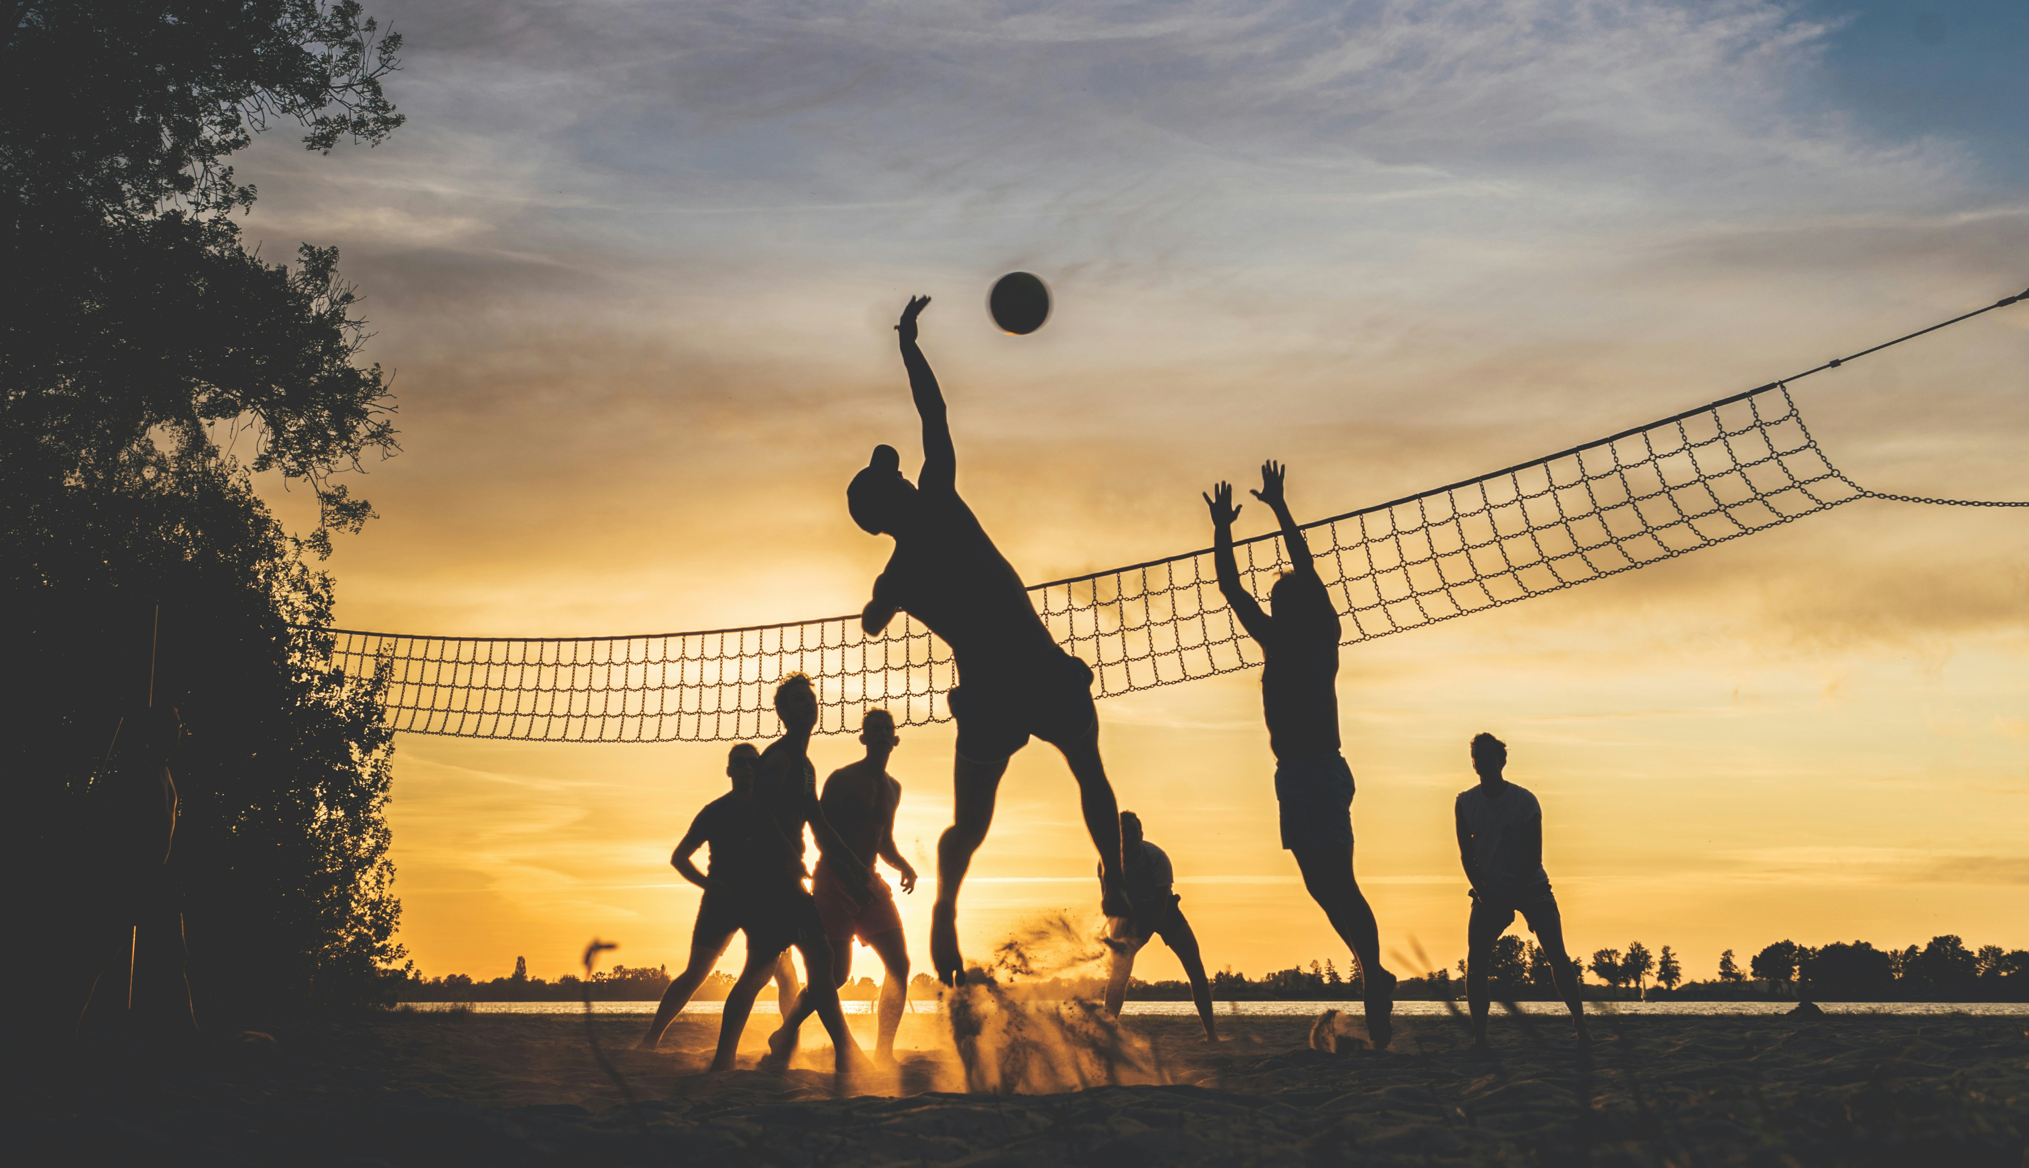
校園故事
Notes:
https://unsplash.com/photos/silhouette-of-people-playing-basketball-during-sunset-0NaQQsLWLkA

Slide 2
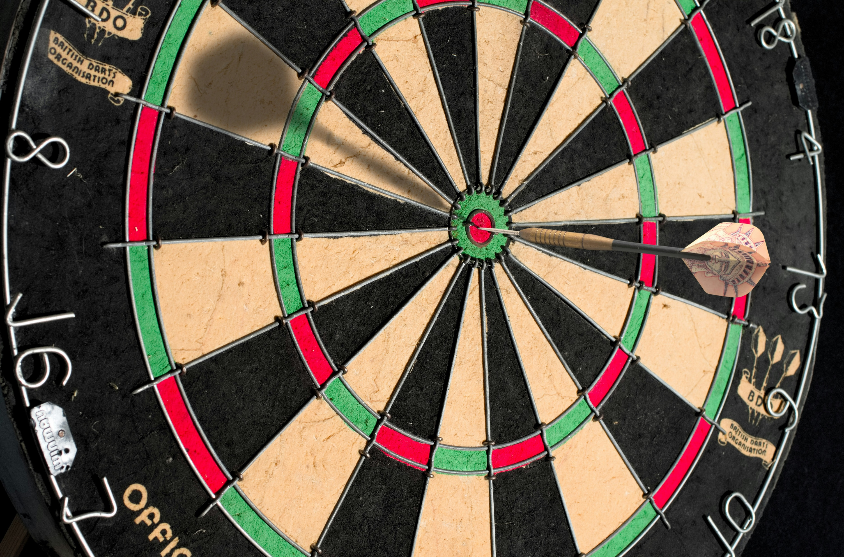
1. 目標

Slide 3
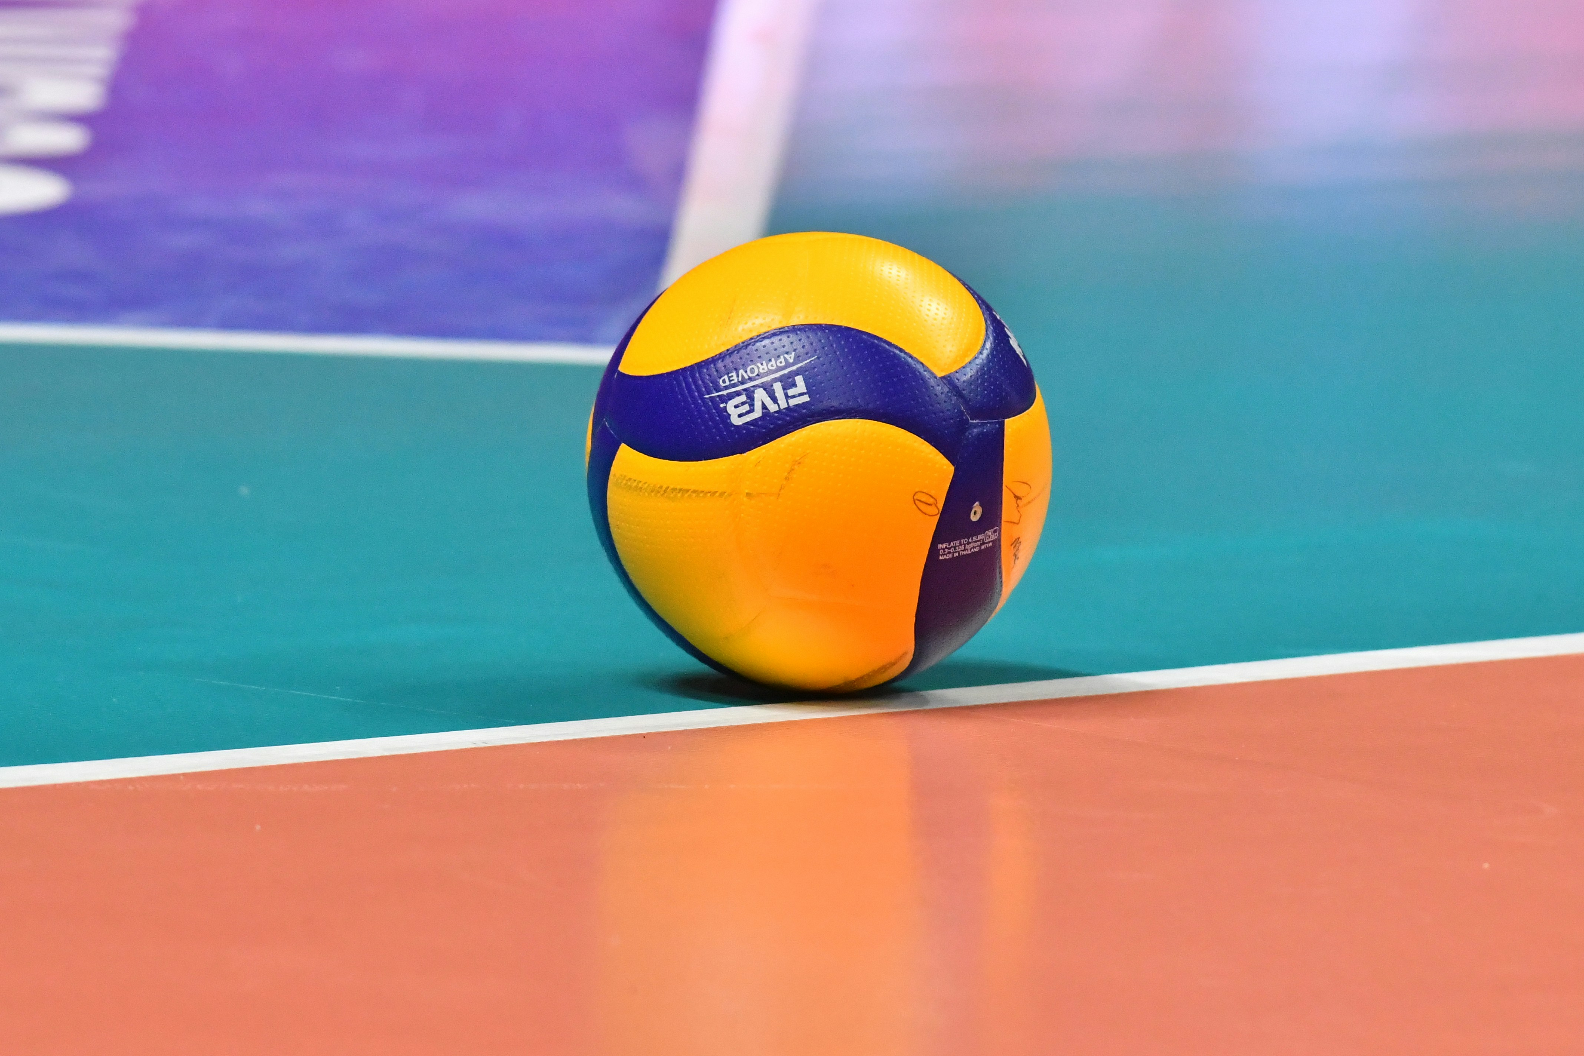
Notes:
https://unsplash.com/photos/a-yellow-and-blue-ball-on-a-pool-table-pYHFDv6vI-o

Slide 4
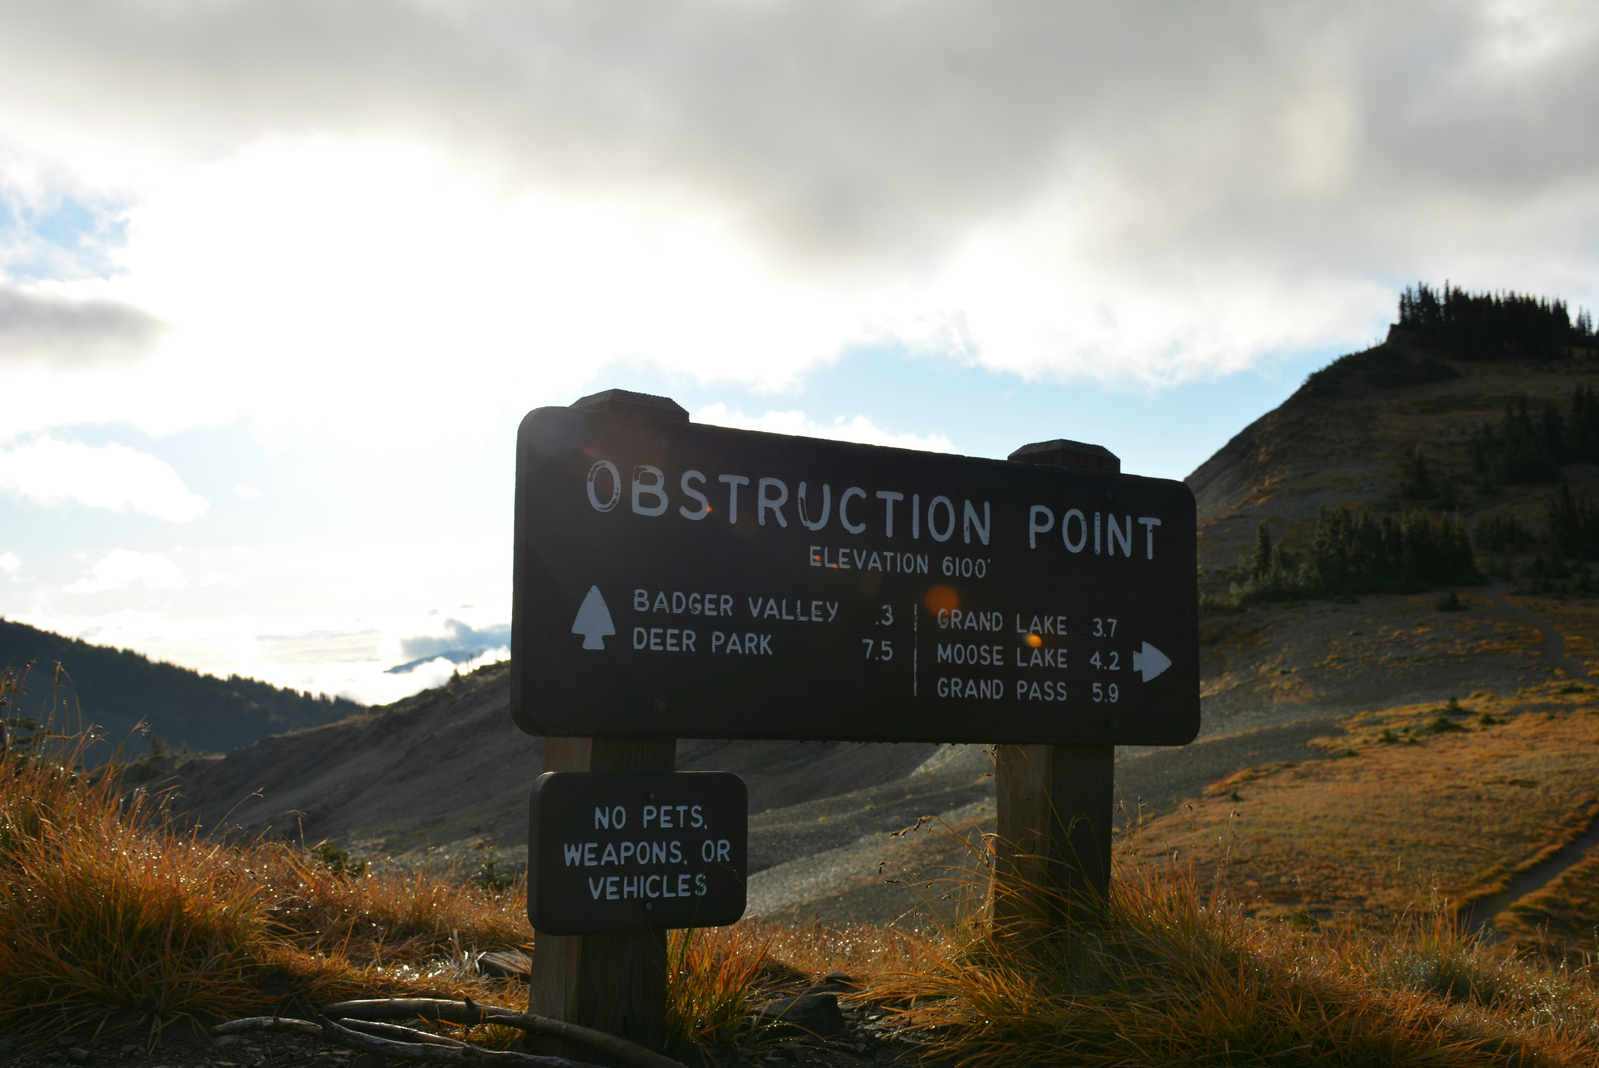
2. 阻礙
Notes:
https://unsplash.com/photos/a-sign-on-the-side-of-a-mountain-pointing-to-an-obstruction-point-KefoI8QxnbM

Slide 5
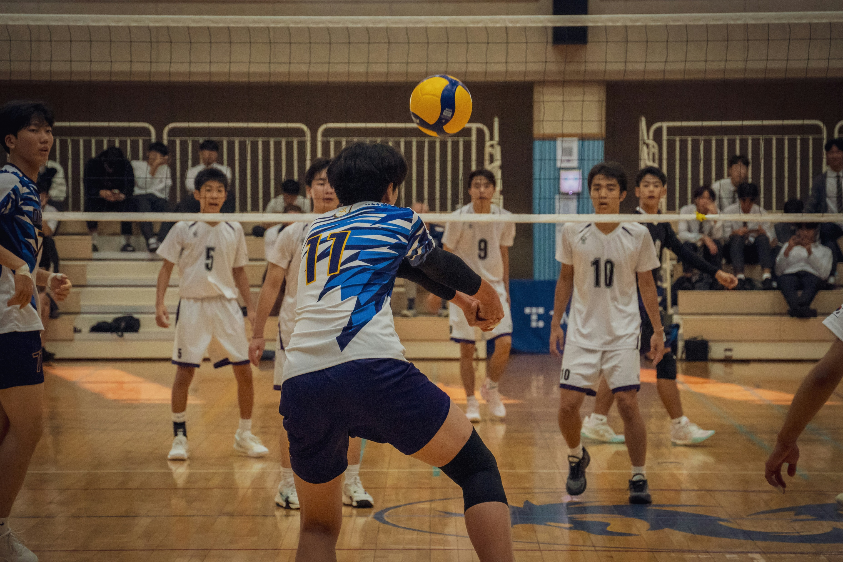
Notes:
https://unsplash.com/photos/a-group-of-young-men-playing-a-game-of-volleyball-BgFVRevbvrg

Slide 6
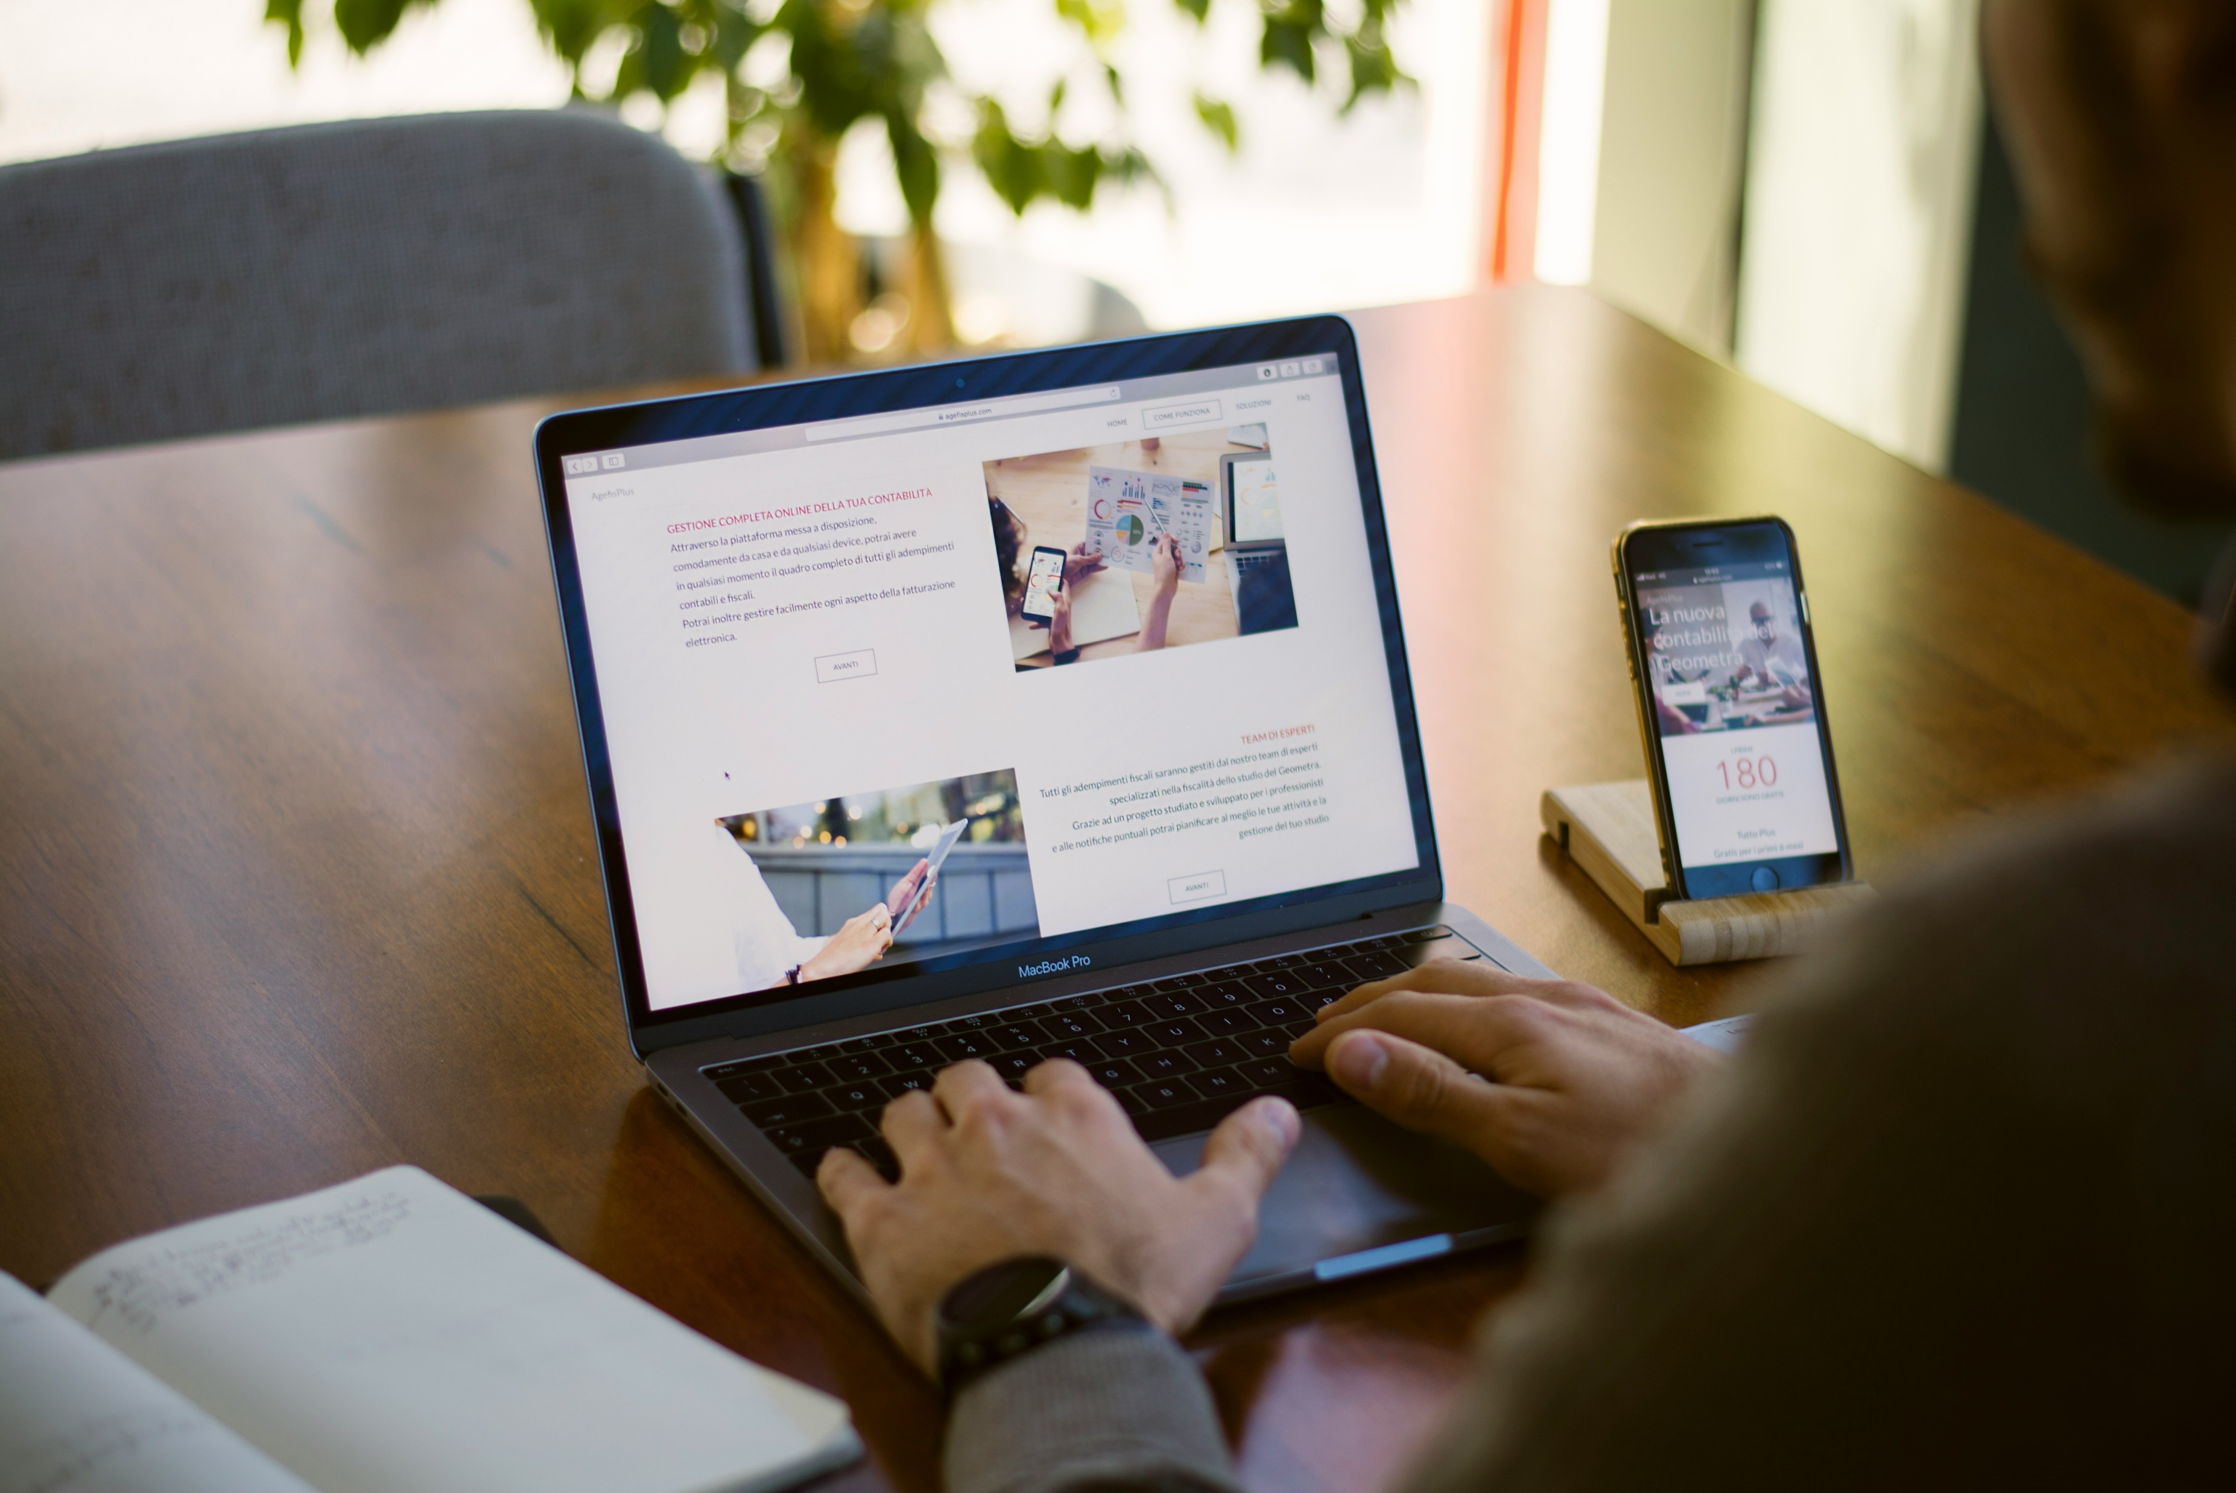
3. 努力
Notes:
https://unsplash.com/photos/person-sitting-near-chain-while-using-macbook-pro-vll0Bb04XTc

Slide 7
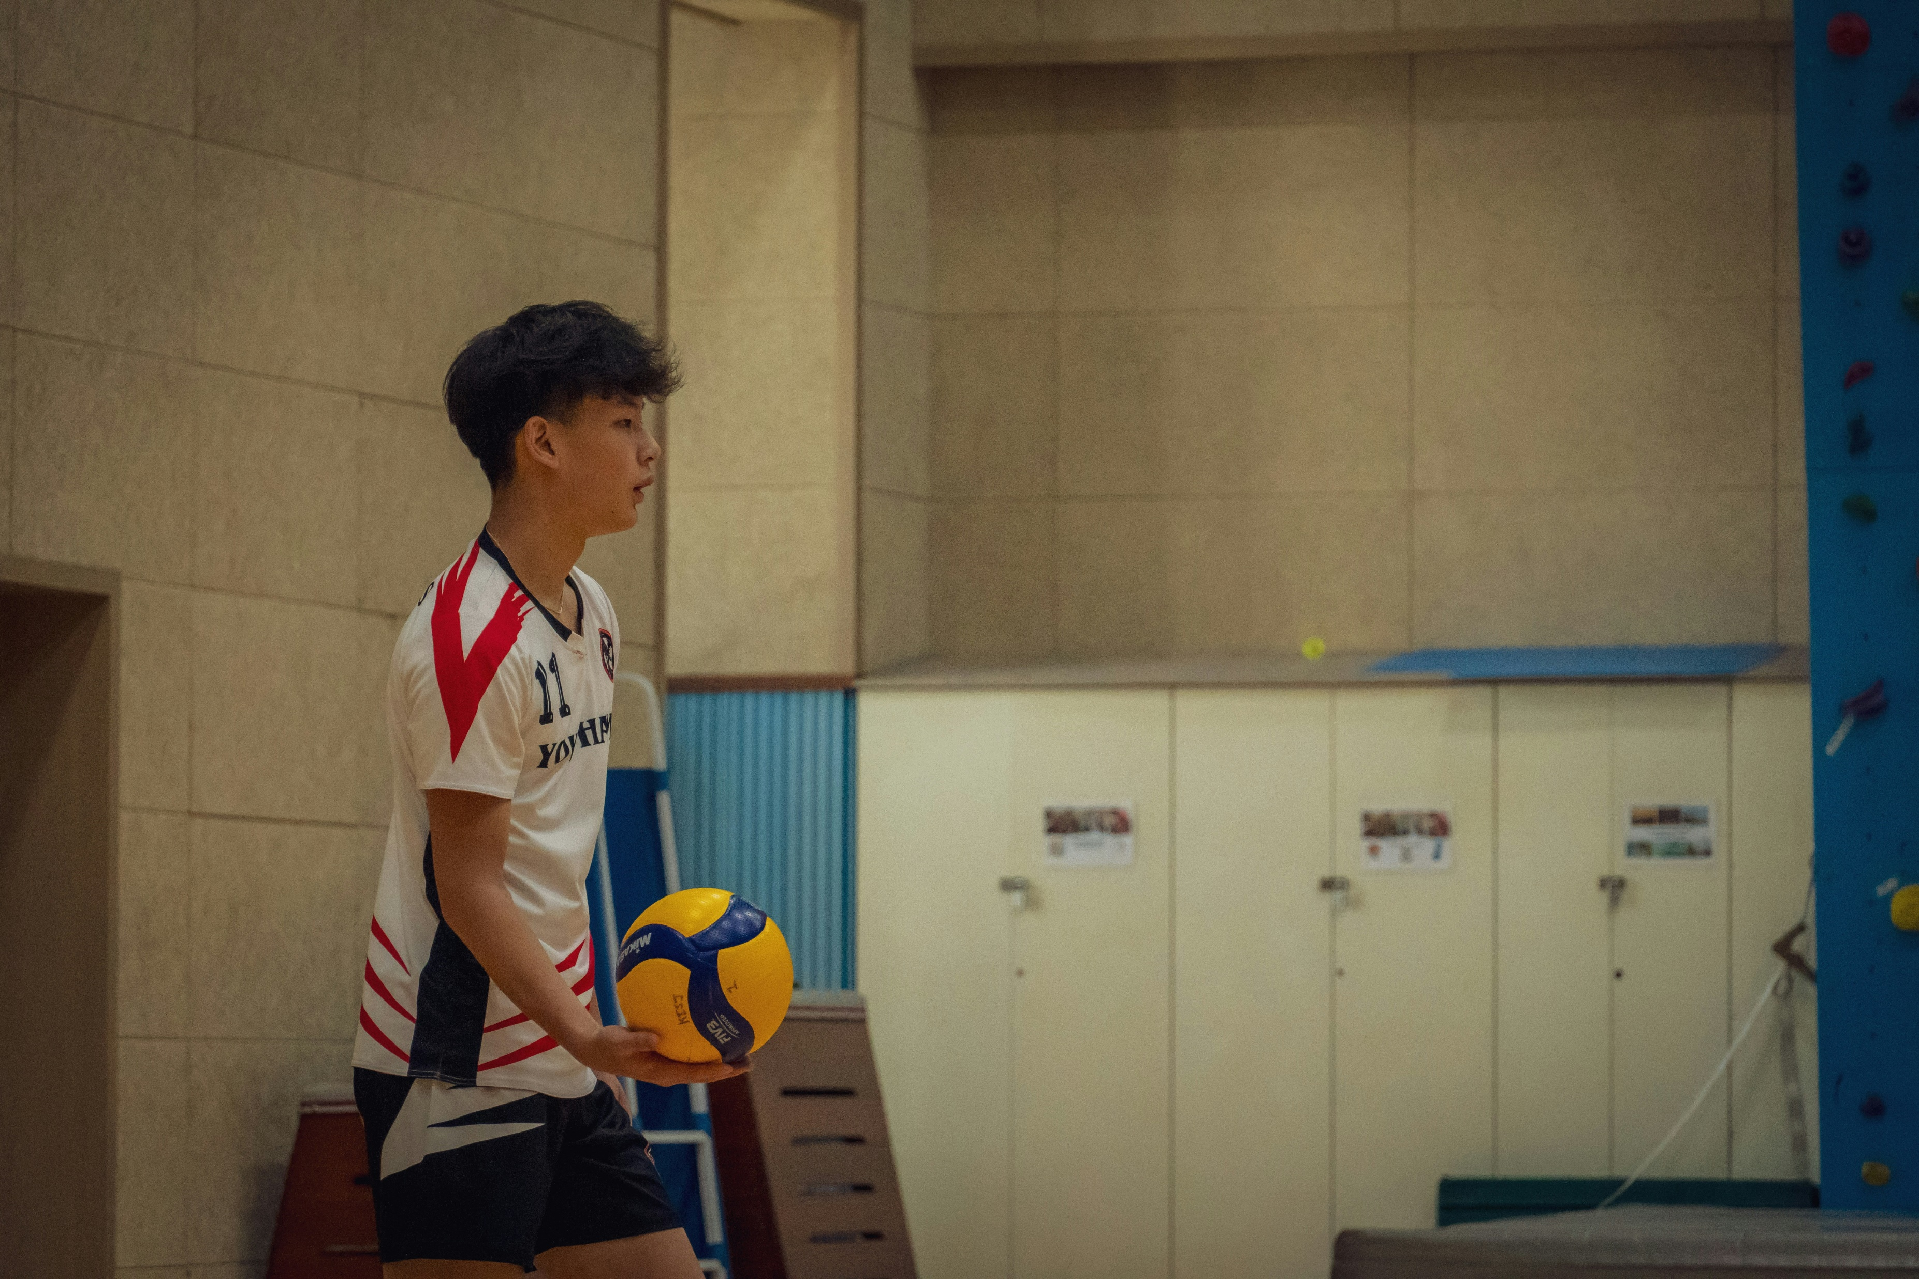
Notes:
https://unsplash.com/photos/a-boy-holding-a-soccer-ball-in-a-gym-d_OYd6TCzv0

Slide 8
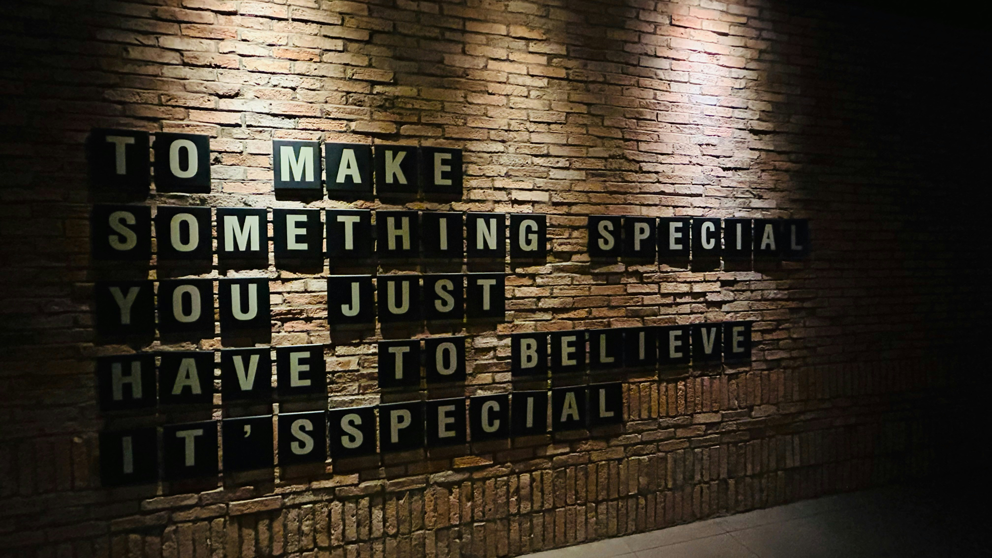
4. 結果
Notes:
https://unsplash.com/photos/a-brick-wall-with-words-written-on-it-sNtGPIgYSOI

Slide 9
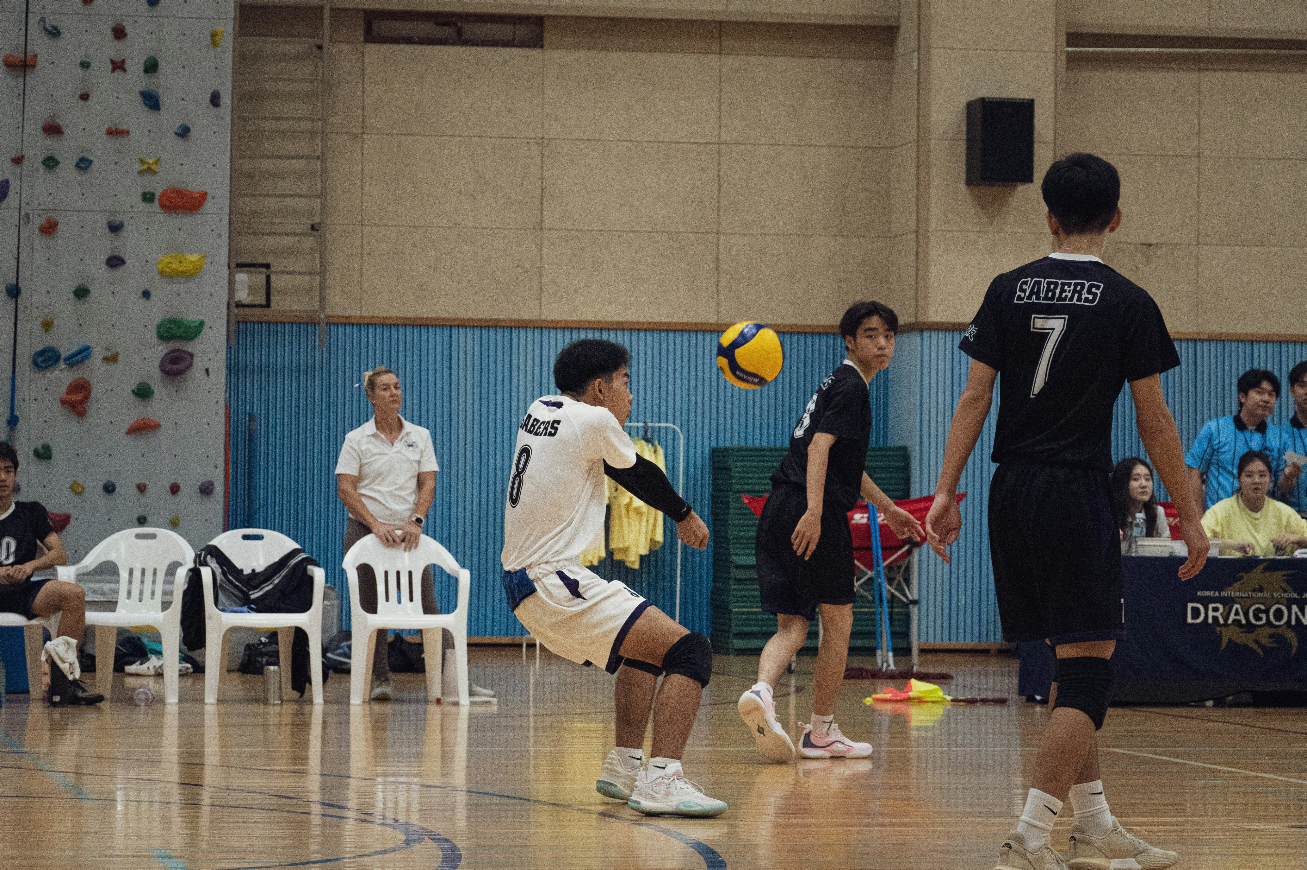
Notes:
https://unsplash.com/photos/a-group-of-young-men-playing-a-game-of-volleyball-D1IZNqe2lYs

Slide 10
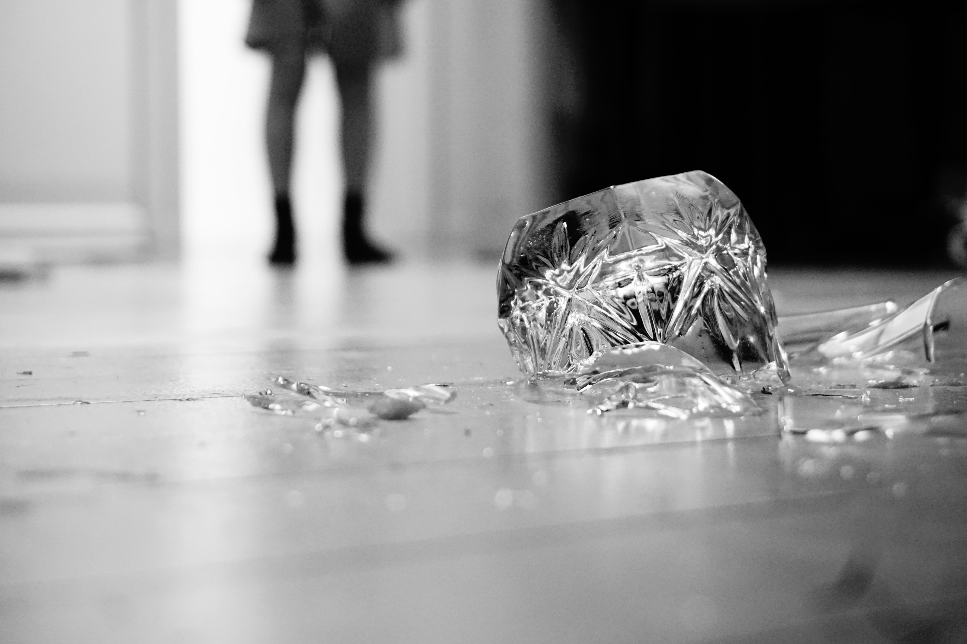
5. 意外
Notes:
https://unsplash.com/photos/a-bag-of-marijuana-on-a-table-goRkKhD8dU4

Slide 11
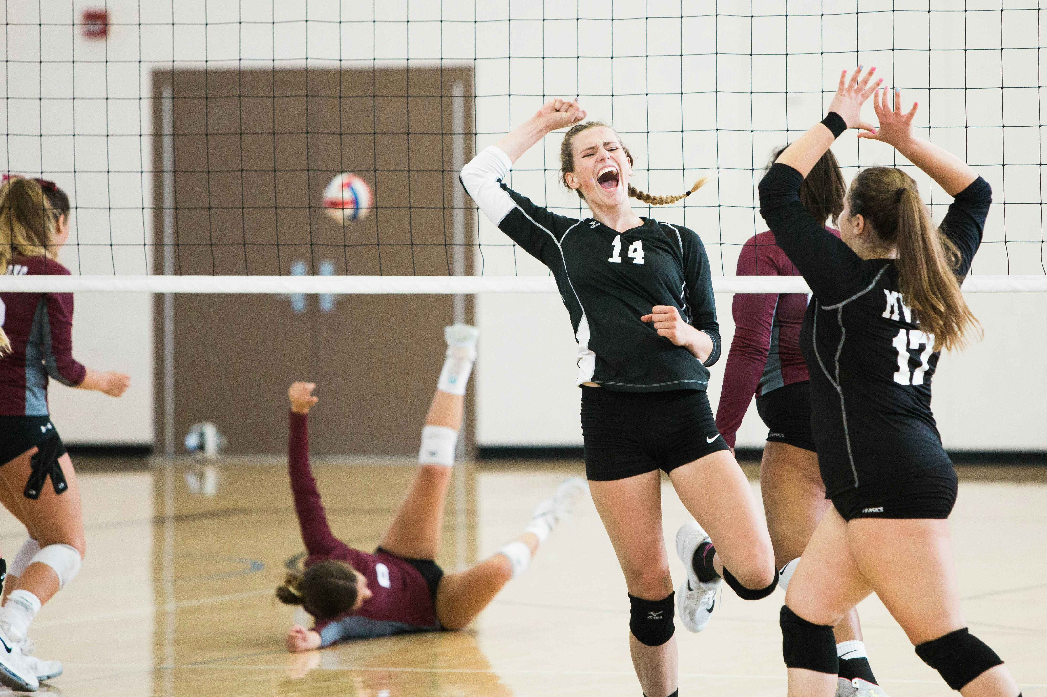
Notes:
https://unsplash.com/photos/women-playing-volleyball-inside-court-aZVpxRydiJk

Slide 12
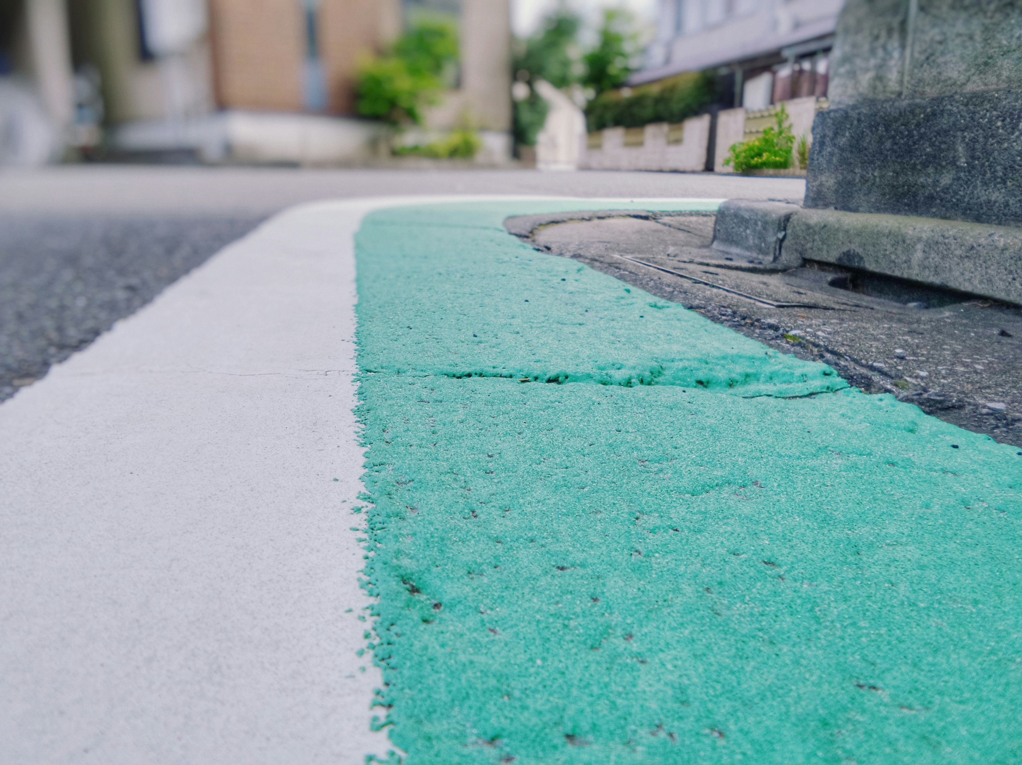
6. 轉彎
Notes:
https://unsplash.com/photos/closeup-photo-of-white-and-teal-painted-corner-street-Bf3Eba4lMdE

Slide 13
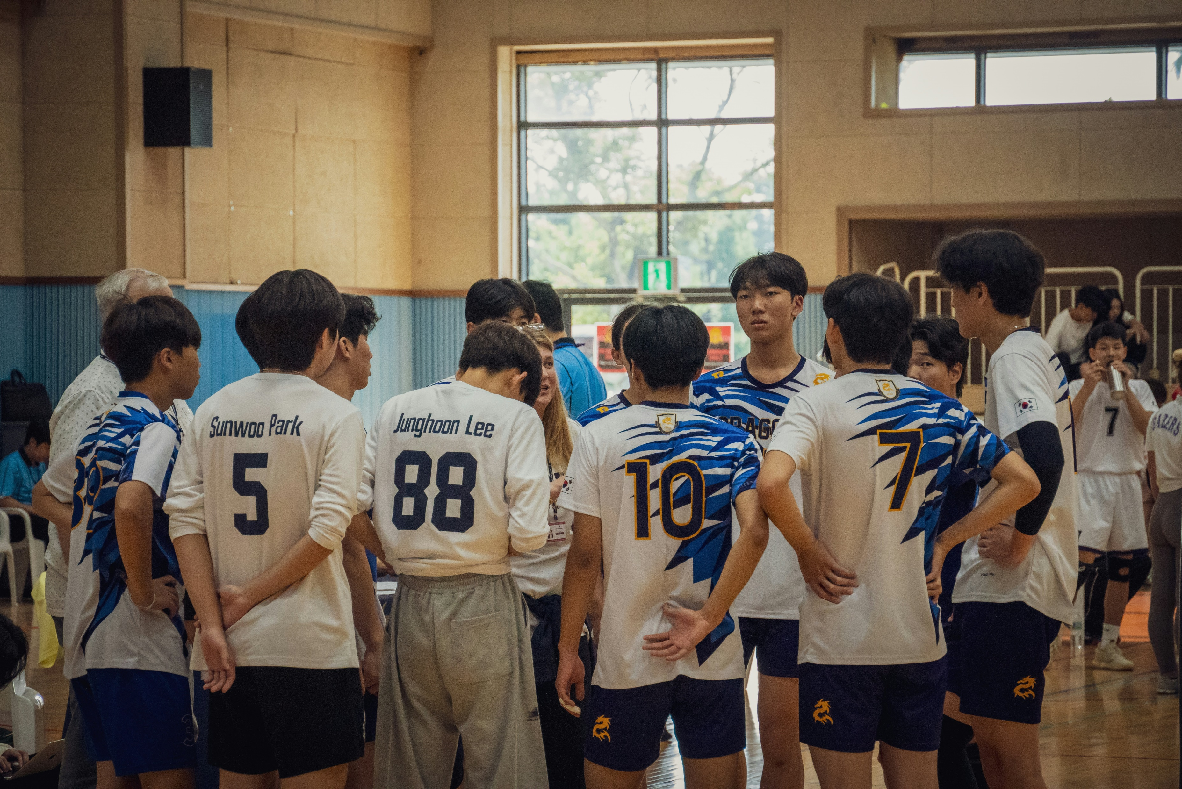
Notes:
https://unsplash.com/photos/a-group-of-young-men-standing-next-to-each-other-r-Ip8SvYK2s

Slide 14
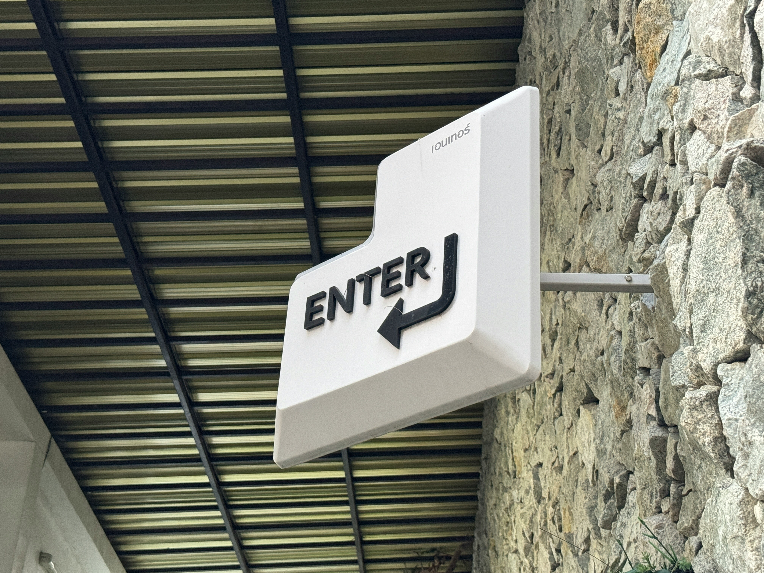
7. 結局
Notes:
https://unsplash.com/photos/a-white-sign-hanging-from-the-side-of-a-stone-building-TvV1wSIm-pI

Slide 15
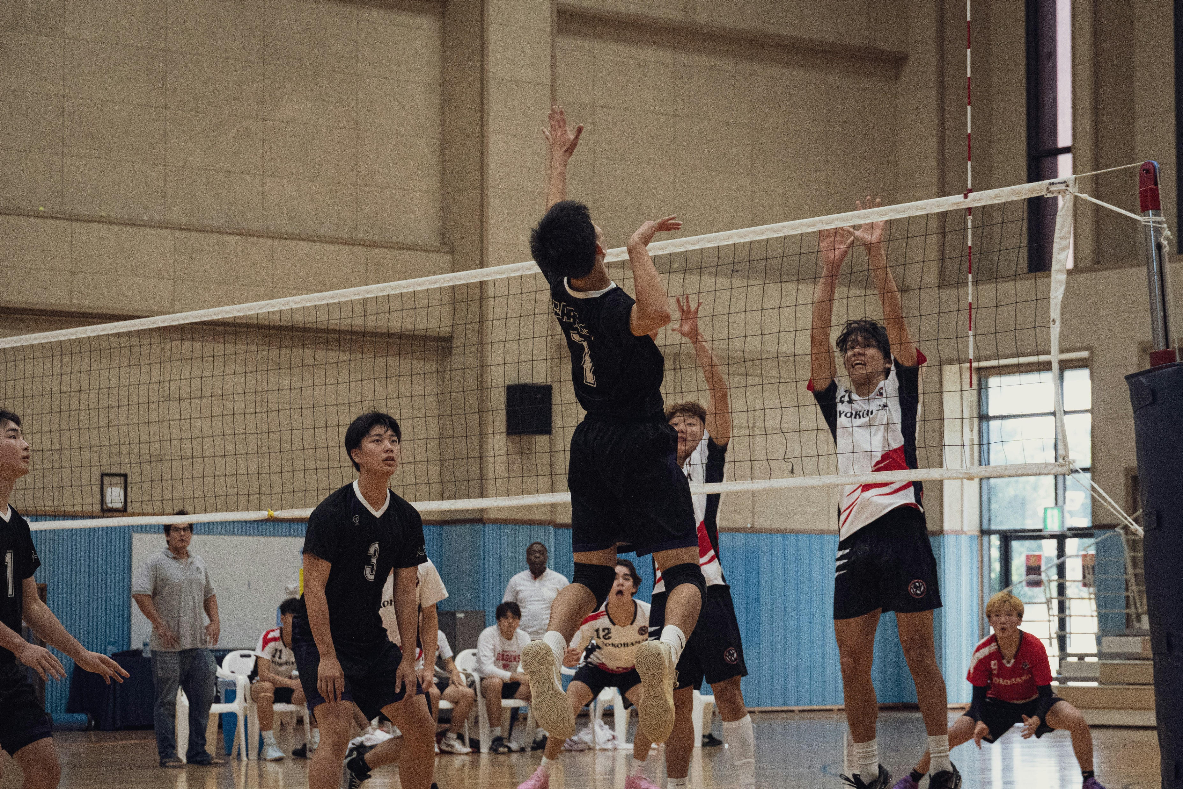
Notes:
https://unsplash.com/photos/a-group-of-young-men-playing-a-game-of-volleyball-MTn5AkX15tg

